Slide 1

ST. VINCENT PALLOTTI COLLEGE OF ENGINEERING AND TECHNOLOGY
NAGPUR
DEPARTMENT OF B.E ELECTRICAL ENGINNERING
7th SEM
EFFICIENT ENERGY GENERATION
Project coordinator Project Guide
PROF.M.A.MAURYA PROF. S.A.SARMOKADAM

Slide 2
NAME OF PROJECTEES:
GROUP LEADER:
OMKAR .R. WANDHARE (68)
GROUP MEMBERS:
1. AKSHAY .H. TALMALE (66)
2. NIKHILESH DINESH (67)
3. VAIBHAV .B. KHANEKAR (70)

Slide 3
OUTLINE

Slide 4
ABSTRACT:
This project deals with the concept of free energy and its generation using flywheel system. A mains motor of 0.25 horsepower capacity is used to drive a series of belt and pulley drive which form a gear-train and produces over twice rpm at the shaft of an alternator. The intriguing thing about this system is that greater electrical output power can be obtained from the output of the alternator than appears to be drawn from the input motor. This is done with the help of Gravity wheel. The gravity wheel or flywheel is coupled with the gear-train in order to produce more excess energy or free energy. Detail study is done with various parameters of flywheel to obtain the maximum free energy out of the system.

Slide 5
INTRODUCTION: Nikola Tesla once said that, all people should have energy sources for free. There is electricity everywhere present in limitless quantities and can drive the world’s equipment without the need for gas, coal or oil. Free energy means zero cost energy. Mechanical energy which drives windmill, or Solar energy in solar cell which is converts into DC current other energies obtained are from wind power, water power & telluric power. Free energy generation is a process to generate these types of energy. Free energy suppression is the notion that corporate energy interests intentionally suppress technologies that may provide energy at very low cost. Free Energy generally means a method of drawing power without fuel to be burnt from the local environment,

Slide 6
Some of the methods which can be used as the free energy devices are as follows:
Battery-Charging Pulsed Systems
Moving Pulsed Systems
Energy-Tapping Pulsed Systems
Aerial Systems and Electrostatic Generators
Motionless Pulsed Systems
Fuel-less Motors
Magnet Power
Passive Systems
Gravity-Powered Systems

Slide 7
Objectives of the Project
The main objective of system is the utilization of gravity using the flywheel.
The primary step for this is to increase ratio of input speed to output speed.
The secondary step is to use the energy generated by the alternator to the load bank
Obtaining the maximum output and calculating the maximum efficiency of the working model

Slide 8
Principle:
The aim of this project is to recover energy of flywheel by using principle of energy recovery system from flywheel and produce enough energy to run the project set up and also some additional energy to run external power supply
The true scientific method is to improvement scientific theory by observed fact and new discoveries, but the true scientific method is not being followed at the present time.

Slide 9
HISTORY OF FLYWHEEL
Flywheels are around for about thousands of years. The initial application is the potter’s wheel. Perhaps the most commonly used application in recent years is in internal combustion engines.A flywheel is a simple form of mechanical energy storing device. Energy is stored by rotating disc to spin about its axis. This energy is proportional to its mass and the square of its rotational speed.

Slide 10
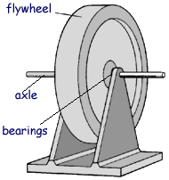
Flywheel mass is either mechanically driven by CVT gear unit or electrically driven via electric motor / generator unit, mechanically driven composite flywheel, electrically driven flywheels Devices that use mechanical energy directly are being developed, but most FES systems use electricity to accelerate and decelerate the flywheel.

Slide 11
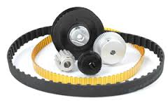
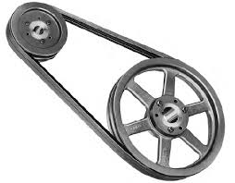
General Consideration:
In this System Design We Mainly Concentrate on the Following Parameters The system consists of design of various parts like Pulley, Flywheel, Belt drive, Shaft, Bearings etc.

Slide 12
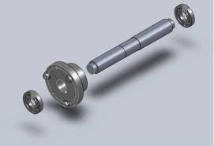
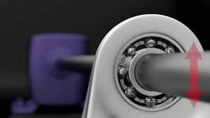
Design of Shaft and Bearings:
There are 2 shaft in the Layout of the system. Thus Design of Shaft is to be calculated in order to find the proper Shaft diameter which would withstand the load easily and to ensure the maximum energy is transfer with minimum loss. Bearing selection is also some important criteria in order to ensure smooth and long lasting functioning of the system.

Slide 13
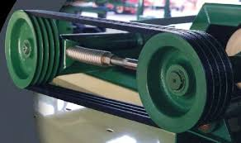
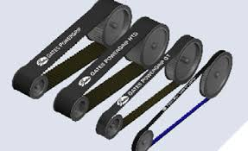
Design of Belt Drive:
At the first stage we selected pulley as per standard specification. We know that a belt drive is useful for the power transmission using pulley. Each pulley has different diameters and speed. The belt, wire (rope) drives are used for the power transmission. In the project, we are going to use total six pulleys, so we need three different belt drives

Slide 14
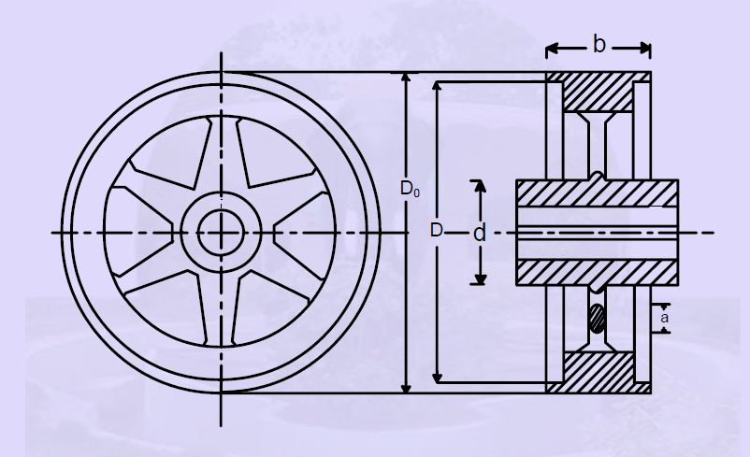
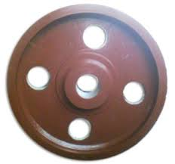
Design of Flywheel:
This Project is all about generation of free energy with using the gravitational energy. Thus we are using flywheel of mass 10kg that can utilize the gravitational energy and give us more output.

Slide 15
Block Diagram
DC SUPPLY
( Battery )
DC MOTOR
( PMDC )
FLYWHEEL
ALTERNATOR
( CAR ALTERNATOR )
LOAD APPLIANCES
( LAPTOP,TUBE LIGHT)
DC TO AC CONVERTER

Slide 16
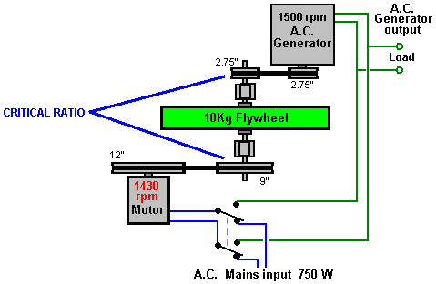
DC ALTERNATOR
PMDC MOTOR
DC

Slide 17
FUTURE ASPECT:
Changing the Flywheel’s weight, size, structure and speed, changes the output of the alternator.
If higher specifications system is used such as 8HP motor, 150kg flywheel could produce 50% more free energy at the output alternator.
Such high end system could extend the life of exhaustible nonrenewable resources for more than 50% of its current life.

